Slide 1
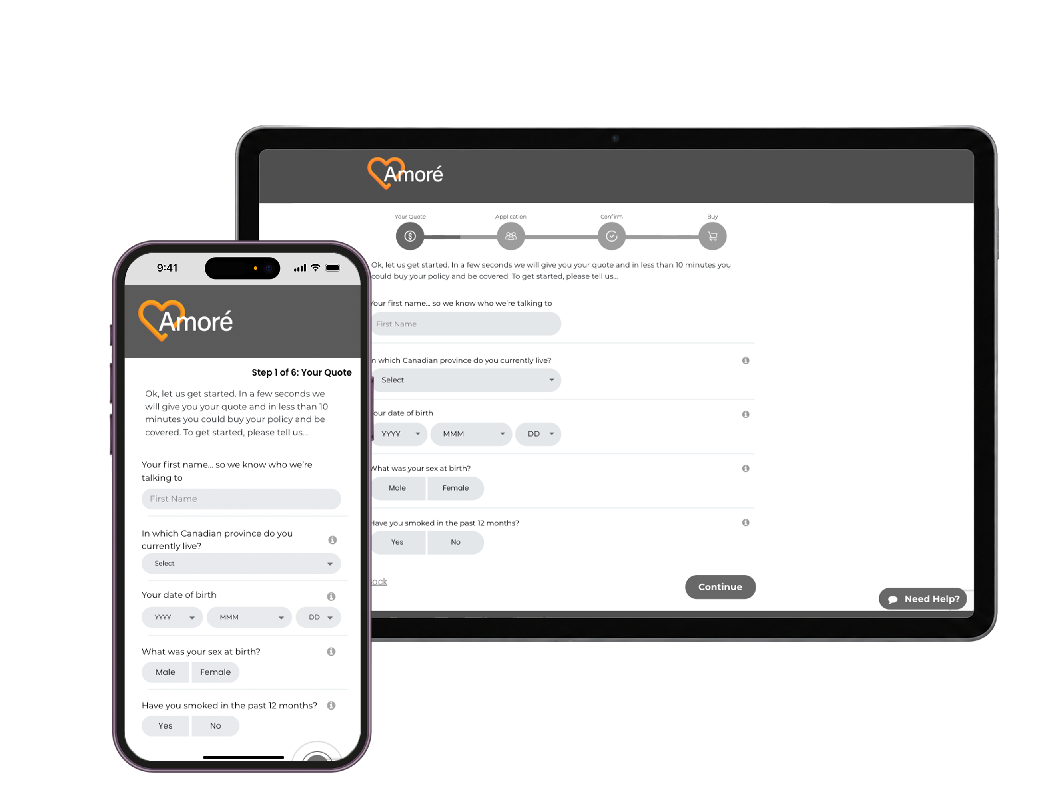

The AI-Powered Life
Insurance Revolution
RiskDX is a complete digital distribution platform designed to simplify quote, apply, underwriting, and policy delivery.
It helps insurers launch faster, sell smarter, and grow revenue through higher completion rates and cross-sell opportunities.
RP
Notes:
Welcome

Slide 2
BENEFITS
What Advisors Face Every Day
01
02
03
Long Processing Times
Missed Opportunities
Poor Advisor Economics
Traditional applications take weeks or months. Underwriting alone averages 42 days of waiting.
Middle-market clients remain underserved by slow, overly complex solutions in the market.
Conventional distribution methods are becoming economically unviable for advisors.
04
05
Complex Underwriting
No Personalization
Multiple handoffs and outdated processes create barriers between advisors and clients.
Generic insurance branding and handoffs actively damage your client relationships.

Slide 3
THE SOLUTION
Four Pillars of the Amoré Advantage
Four Pillars of RiskDX
01
02
03
04
AI-Powered Processing
Flexible Coverage
Enhanced Efficiency
Personal Branding
Streamlined compliance and accelerated applications. Immediate underwriting decisions with no compromise on competitiveness or product design.
Any term from 5 to 40 years. Up to $2,000,000 in coverage. Convertible, renewable, and tailored to every client’s life stage.
Eliminate paper forms and multiple handoffs. Clients self-serve from your personal website, or you guide them through every step.
Your own website, URL, logo, and branded communications. Sell as yourself — not as a generic insurance company representative.

Slide 4
Traditional Sales Process
Quote
Apply with Payment
Submit to Underwrite
Sign Amendment
Bind
Deliver
55 Days (Avg)
Underwriter Review
Offer
Paper-based
Multiple hand-offs
Inefficient and slow
Ignores advisor compliance
Not designed to optimize sales
Additional Tests
42 Days
Underwriting alone takes on average 42 days!
Notes:
We all know the traditional sales process is slow and inefficient.

Slide 5
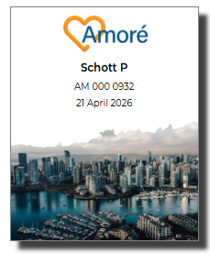
Sales Process Reimagined
Quote /
Needs Analysis
Apply and Underwrite
Offer
Buy and Deliver
Minutes, not days
Key Features Overview
Incorporates needs analysis
Optional with eligibility
Self-serve or advisor initiated
Review Timeline Options
No fluids allowed
Immediate review
24-hour review for UW
Best available product – offer simplified issue if applicant does not qualify for fully underwritten coverage
Customer can select coverage based on offer terms, buy and download the policy.
Fully-underwritten policies in 12 minutes, start-to-finish
Submit to Underwrite
Purchase
Download Policy
Notes:
Digital process should not be simply replacing paper processes with electronic apps. Amoré is simple and predictable.
The process can start with a quote, needs analysis or go straight in and test eligibility.
Then the
Riskdx returns an offer

Slide 6
THE PLATFORM
Everything You Need, In One Place
Personal Website & URL
Omni-Channel Journey
AI Compliance Engine
Free branded site for every advisor. Share on social or email — clients self-serve and buy instantly.
Quote, apply, underwrite, and deliver — entirely digital in one seamless, advisor-controlled flow.
Auto-generated disclosure forms, reason-why letters, and complete audit trails per sale.
Branding Packs
Real-Time Notifications
Performance Dashboard
Professionally crafted videos, images, and landing pages that reflect your personal advisor brand.
Know instantly when clients interact. View progress or jump in to assist at any point in the journey.
Embedded analytics to track sales, conversion rates, pipeline health, and client engagement data.
Designed for advisors. Loved by clients. Powered by RiskDx.
amoreinsurance.info | Powered by RiskDx

Slide 7
BENEFITS
Consumer Benefits
01
02
Choice of Interaction
Issued in Minutes
Applicants want the choice as to how to buy. We deliver that, with support when needed.
The idea of waiting days, weeks or even months for a policy to be issued is century-old thinking. Today’s modern consumer expects better.
03
04
Fully Underwritten
Empowered Decision Making
Underwriting ensures the applicant gets the best possible price based on their health, not a pool of sub-standard lives.
Our optional Needs Analysis tool presents the customer with a range of options and the associated cost of each. The customer feels they are in control of the process as they have the information they need to make an informed decision.
amoreinsurance.info | Powered by RiskDx

Slide 8
BENEFITS
Advisor Benefits
01
02
03
Customizable Process
Personal Landing Page
Personal Sales Links
The advisor defines the sales process that suits their market.
The advisor has their own personal landing page reflecting who they are.
Advisors have their own personal sales links to share on social media or send directly to prospects.
04
05
Integrated Compliance
Immediate Decision
Compliance requirements, such as the Reason Why Letter, integrated into the sales process to simplify the process for advisors.
Advisors prefer the clarity of an instant decision, and it also means they get paid quicker.
amoreinsurance.info | Powered by RiskDx

Slide 9
BENEFITS
Insurer Benefits
01
02
03
Sales and Marketing
Configurable
Compliance
Integrated sales and marketing tools enable rapid customizable deployment.
RiskDX can be rapidly configured to meet your branding and sales process.
Embedded rules ensure all sales meet compliance standards.
04
05
Improved Underwriting Outcomes
Analytics
Our automated underwriting process improves the accuracy and consistency of underwriting decisions. Changes can be implemented rapidly and analytics support continuous improvement.
By digitizing the underwriting process, insurers gather detailed and accurate data that can be used to gain business insight and improve decision making.
amoreinsurace.info | Powered by RiskDx

